Slide 1
Distributive Justice II Liberal-Egalitarianism
Introduction to Political Theory
Semester 2 Week 8 Lecture
Dr. Billy Christmas

Slide 2
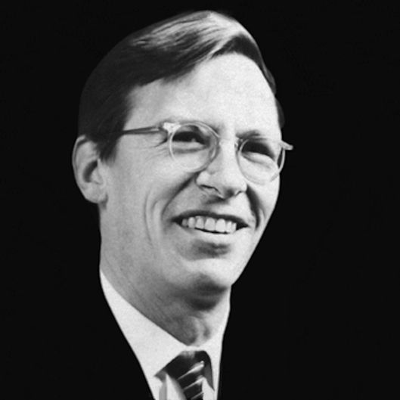
JOHN RAWLS
A THEORY OF JUSTICE

Slide 3
Utilitarianism The greatest good for the greatest number One individual’s welfare can be sacrificed for the greater welfare of others

Slide 4
“Utilitarianism does not take seriously the distinction between persons” (p. 24)

Slide 5
So act that you treat humanity, whether in your own person or in the person of any other, always at the same time as an end, never merely as a means. (Groundwork for the Metaphysics of Morals, 1785)

Slide 6
Concept of justice: principles that govern the basic structure of society, understood as a system of cooperation for mutual benefit Conception of justice: fairness

Slide 7
Traditional Social Contract Imagines a scenario of real contractors, contracting in the context of morally arbitrary inequalities This yields a mere modus vivendi – it is not a fair system

Slide 8
The Original Position Purely theoretical heuristic for ensuring we derive fair principles of justice The Veil of Ignorance We do not know who we are in society (we only have general social scientific knowledge, and self-interest)

Slide 9
MAXIMIN

Slide 10
In searching for the most favoured description of this situation [the original position] we work from both ends. […] By going back and forth, somethings altering the conditions of the contractual circumstances, at others withdrawing our judgements and conforming them to principle, I assume that eventually we shall find a description of the initial situation that both expresses reasonable conditions and yields principles which match out considered judgements […] (p.18)

Slide 11
Intuitions
Original Position
Principles of Justice
If principles are inconsistent with intuitions, OP may have to be revised

Slide 12
The first Principle Maximal equal liberty Civil rights Political Rights Procedural Rights

Slide 13
The Second Principle A. The Difference Principle Socioeconomic inequality is only permissible to the extent that it benefits the worst of in society B. Fair Equality of Opportunity Such positions of advantage must be subject to equality of opportunity

Slide 14
The difference principle

Slide 15
 | Group A | Group B | Group C
Scheme 1 | 20,000 | 60,000 | 80,000
Scheme 2 | 30,000 | 30,000 | 30,000
Scheme 3 | 25,000 | 50,000 | 100,000
Scheme 4 | 40,000 | 45,000 | 90,000

Slide 16
Challenges to the Difference principle

Slide 17
Would parties in the Original Position really adopt maximin? Would they not opt for maximum expected utility?

Slide 18
Why not equality? Individuals committed to justice should not need to be incentivised to provide benefits to the worst off

Slide 19
Is any redistribution compatible with the Liberty Principle? Economic freedom implies the right to buy, sell, contract, and accumulate

Slide 20
FAIR EQUALITY OF OPPORTUNITY

Slide 21
Whilst certain positions, offices, occupations may give their holders significant socioeconomic advantages (as per the difference principle) to induce them to positively contribute to society in ways that benefit the worst off Such positions themselves must be equally open to those of equal talent Cannot be assigned on morally arbitrary bases

Slide 22
Regime Types Laissez Faire Capitalism Welfare-State Capitalism Property-Owning Democracy Liberal Socialism

Slide 23
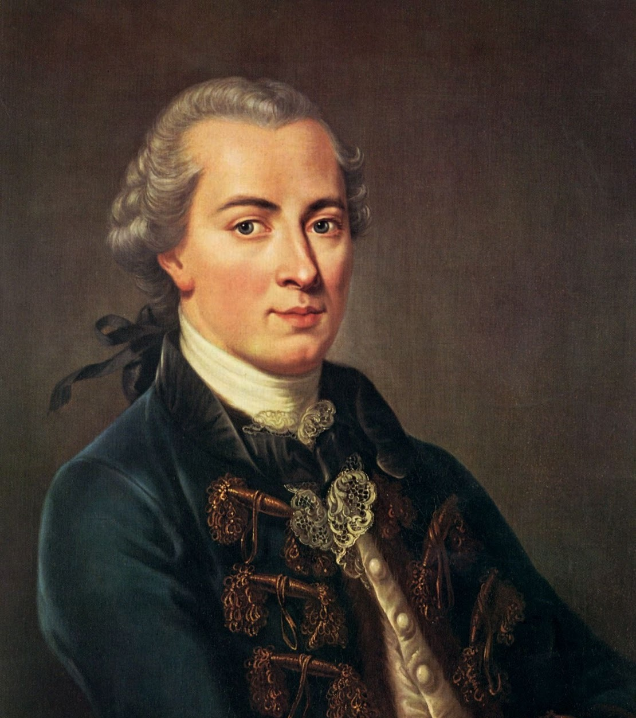
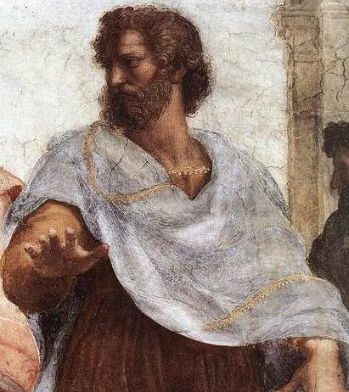
UNENCUMBERED SELVES?

Slide 24
MICHAEL SANDEL Persons are constituted by their shared ends and by their social attachments Individuals prior to their ends and mutually disinterested are not moral agents

Slide 25
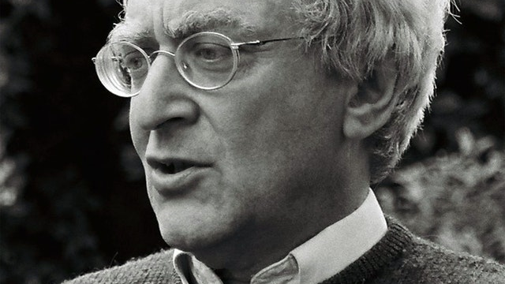
If you’re an egalitarian, how come you’re so rich?

Slide 26
Does justice govern the basic structure of society? Or is justice a personal ethos?

Slide 27
Thank you!

